Slide 1
DNA damage-associated GO terms in DEGs and Cormotifs

Slide 2
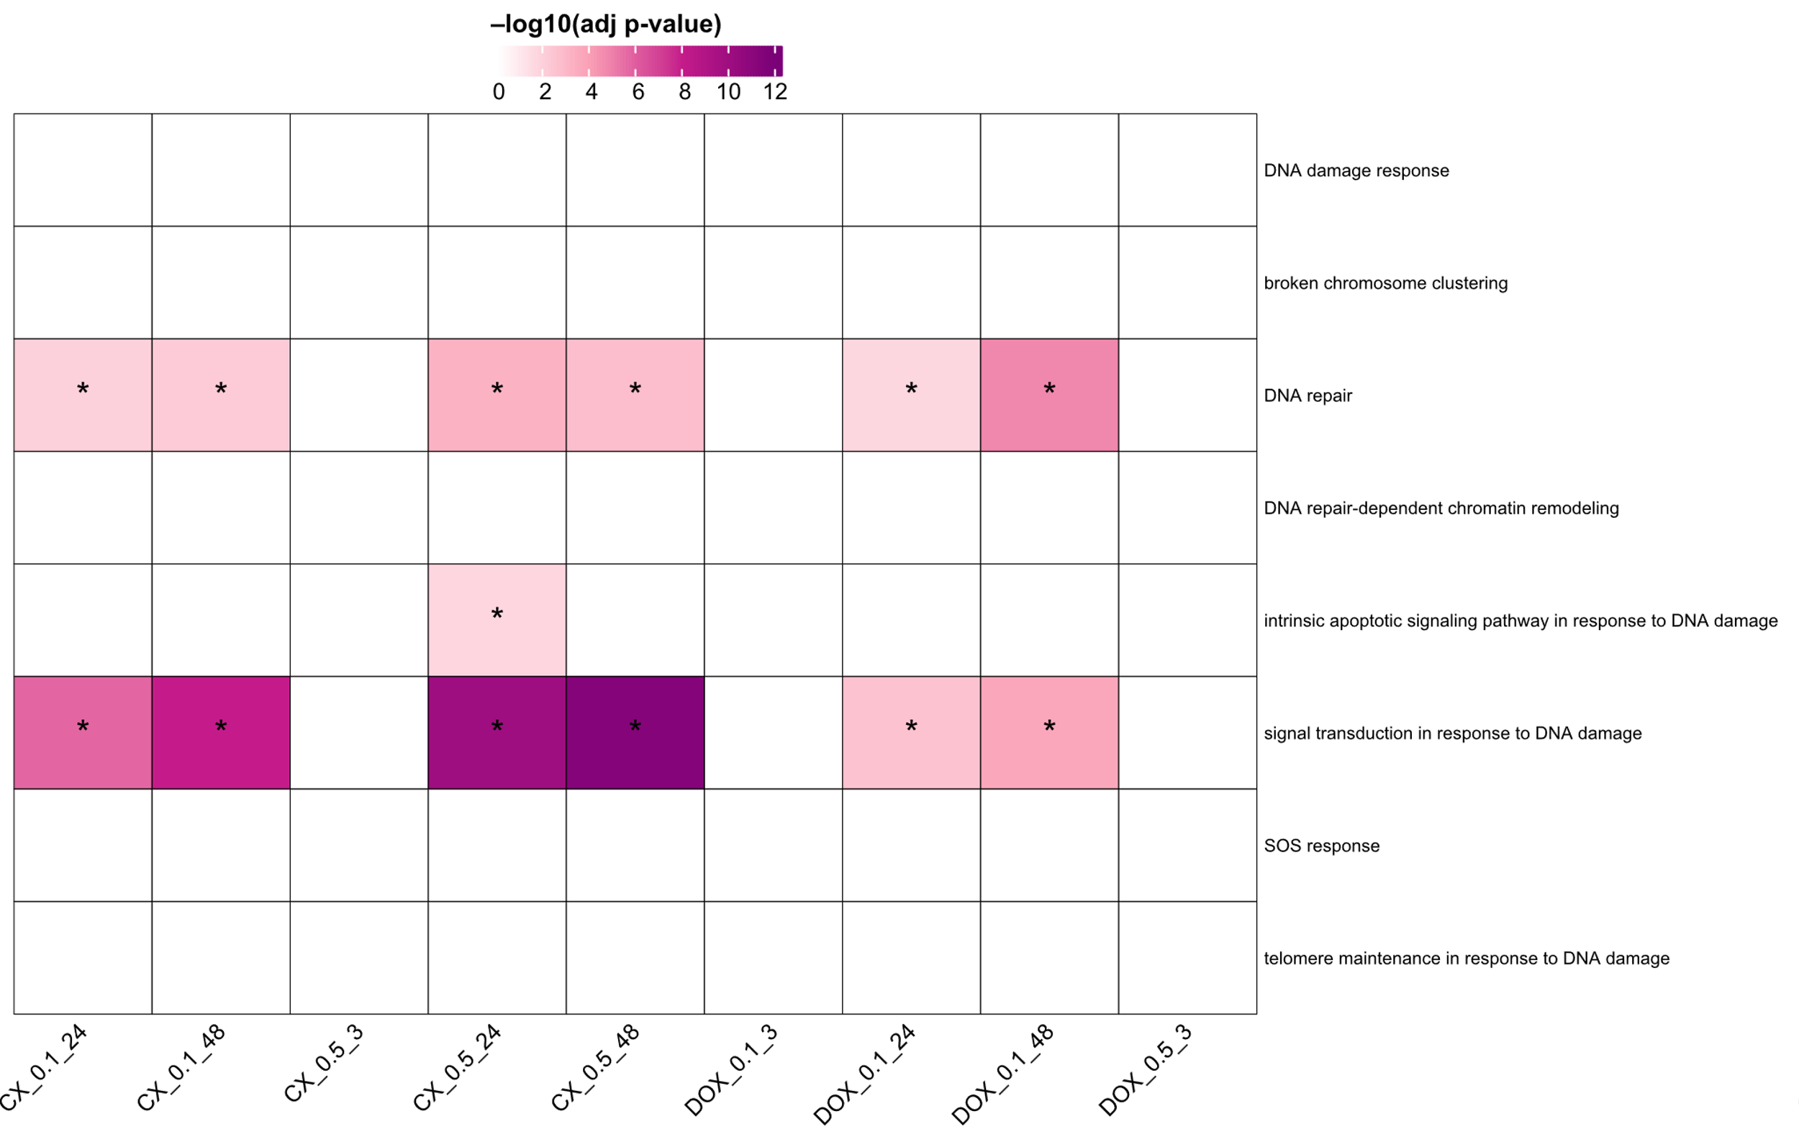
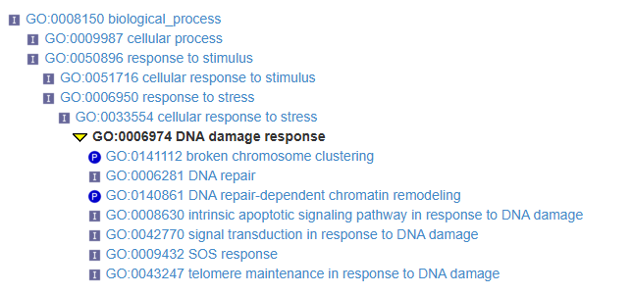
DNA damage associated GO terms

Slide 3
